Slide 1

The Internet of Things and Embedded Development
Or
How to Contribute to the Robot Apocalypse
with the .NET Micro Framework
Copyright Ray Stevens 3, www.dieselsweeties.com
Michael Phelps
Phelps Consulting.
Think software, not swimwear.
Copyright 2015, All rights reserved.

Slide 2
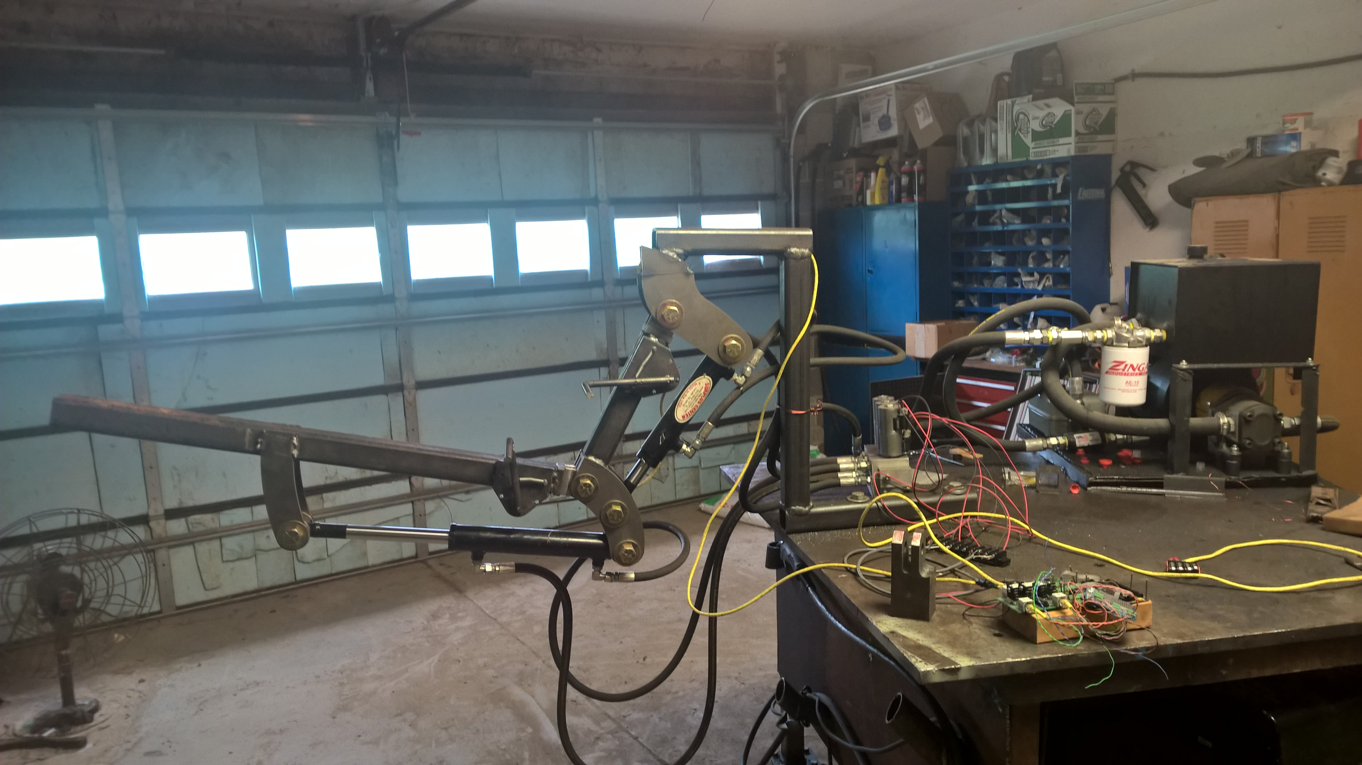
Who am I to talk about this?
Hydraulic exoskeleton arm prototype, 2014-2015

Slide 3
What's a “Thing”?
A device with computer hardware and software, designed for a dedicated function.
Interacts with the environment or user by acquiring data and acting on it in some way.

Slide 4
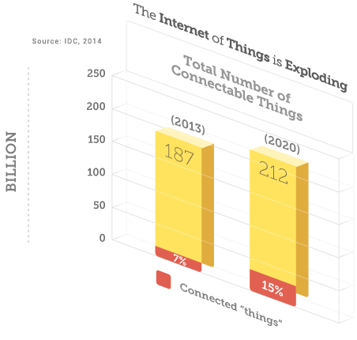
What is an “Internet of Things”
An ecosystem of things that talk to other things via networks.
  Over wifi, bluetooth, LAN
  Local (Intranet)
  Remote (Internet)
Market is expanding

Slide 5
How to be an IoT Developer
Have you ever used one of these?
  Web service
  Database
Congratulations, you are already an IoT developer.

Slide 6

Thanks for coming!

Slide 7
IoT is really Embedded Development
The meat of IoT is in the
  Devices that do the work.
Data transmission (the “Internet” part) simply adds transmission and persistence.
  Analysis and aggregation of the (big) data

Slide 8
Device Platform – Full OS
Runs a complete OS like Linux, Windows, Embedded/CE
Raspberry Pi - Linux. Code in Python, C, C++, many others. Win10 soon!
BeagleBoard – Linux. Code in BoneScript, a JS library in NodeJs.
Lower performance, lots of overhead.
Big resources.

Slide 9
Device Platform – Bare Metal
Runs without OS
You are responsible for basic services like memory allocation, file access, networking
C/C++, Assembler
Really hard
High performance
Industrial systems
Tiny resources

Slide 10
Device Platform - Maker
Offers thin firmware layer as an API to access device resources. Abstracts away much of the direct hardware access.
Generally still offers direct register access in some way.
Gaining traction due to ease of use.
Medium resources

Slide 11
Maker Platforms
Arduino – Everyone get “The Arduino Starter Kit”! Limited C/C++, but pretty easy. Great intro to electronics.
Netduino – NetMF, Arduino compatible.
GHI FEZ – NetMF, great vendor support, MS partner for Gadgeteer. Open source and proprietary boards. Production ready options available.
Many others

Slide 12
Meet the.NET Micro Framework
Created by MS around ~2004. Basis was the SPOT smartwatch. (Smart Personal Objects Technology)
SPOT is dead, but .NetMF came out of it.
For 64KB RAM or better.
Limited clone of the full .NET framework
C#, VB only.
Not machine code.
  Interpreted
  no JIT
  no unsafe code.
Open source, part of .NET Foundation

Slide 13
Getting Started
Get a development board
Visual Studio
NetMF SDK – version will be specific to the board you choose.
Vendor specific extensions
Device Firmware
Each vendor has a getting started page that tells you what to install, and in what order.

Slide 14
Gadgeteer
Rapid prototyping platform.
Standardizes electrical connectors.
Wrapper class libraries and designers for many devices.
Hides the infinite loop, uses an event dispatcher.

Slide 15
Blinky
Blinky is the embedded equivalent of “Hello World!”
Tests:
  Your dev environment works
  The device can power on and initialize
  You can deploy to the device/communicate
  Basic hardware functionality
Demo!

Slide 16
“I”s and “O”s
There are some basic objects for getting input and sending output.
  InputPort – Reads a binary input.
  OutputPort – Sends a binary output.
  AnalogInput – Reads an analog input (resolution is ADC dependent). Value is either an int or double between 0 and 1 inclusive.
  PWM – Pulse Width Modulation. Method of simulating an analog output without a DAC.

Slide 17
Interrupts
Interrupt Port – Fires event on input changes.
Interrupts prevent the need to poll.
Improve efficiency

Slide 18
More complicated demo
Gadgeteer Designer
Get SPOT IO objects and methods
Get Gadgeteer IO objects and methods
Show encapsulation of IO in a class.
Demo!

Slide 19
Other Types of “I” and “O”
Complicated messaging protocols are supported in software depending on your device.
  I2C (Inter-Integrated Circuit) – One way chip communications on a single PCB.
  SPI (Serial Peripheral Interface) – Two way chip communications on a single PCB.
  CAN (Controller Area Network) – Multi master communication bus. Noise tolerant. Good for connecting devices over long distances (max 1000 meters) and in industrial environments.

Slide 20
Key Framework Features
No Generics. No plans due to performance hit.
  Lots of casting if you use the collection types.
  Use raw arrays of the correct type.
No Linq. Microlinq may help.
Extension methods (may need to define ExtensionAttribute)
Lambda syntax

Slide 21
NetMF is Not Real Time
Real time (“Time Critical”) means:
  Guaranteeing that inputs and outputs are handled based on a time constraint.
  Generally accepted to be ms or us response time.
There are always at least two NetMF threads
  Application code (what you write)
  Garbage collector (can preempt you any time it wants)
Thread scheduler is simple 20ms time slices.
Heavy GC or threading = lost data.
GC and Threading Demos!

Slide 22
Faking Real Time
GC can be avoided mostly like full framework.
  Avoid boxing
  Statelessness
  Reusable object pools. Circular buffers are good.
  Avoid strings (immutability)
  Structs are treated like reference types!
For a real example, search for “netmf quadcopter”.
Lots of testing!

Slide 23
Testing? Failures? Who cares?
What are the ramifications of code failure for these types of devices?
  Toys/games
  Appliances – like an alarm clock or coffee maker
  Automated industrial machines
  Machines with an operator/passenger, medical devices

Slide 24

Failures in Toys
Nothing lost.
Mad users.

Slide 25

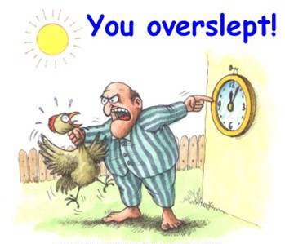
Failures in appliances
Alarm clock – user doesn't wake up
Coffee maker – user doesn't wake up
Washing machine – property damage
Mad users
Small claims (but not always)

Slide 26

Failures in Industrial Machines
Machine crash
Production line stoppage
Real time requirements may apply
Mad shareholders
Machine damage
Lost products and materials
Big lawsuits

Slide 27
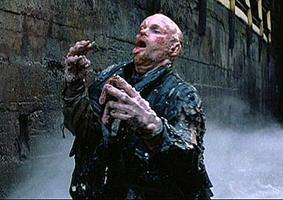

Failures in Passenger Devices
Machine/operator interference
Medical devices – over/under dosage
Aircraft - crashes
Real time requirements may apply
Injured or dead users
Mad governmental authorities
Mad insurance companies
Mad public/watchdog groups
Criminal court
Prison

Slide 28
Security
Security is as important as in hosted software
Users (Hackers) have your device and your code.
Security deficiencies in current devices
  Some ATMs can flash firmware from a USB stick, allowing arbitrary code to be loaded.
  Some insulin pumps have unprotected wireless interface. An attacker can control all settings, including dosage.
  Vehicles with OnStar can be hacked via the diagnostic port, allowing remote control of throttle, brakes, locks, etc.

Slide 29
Methods for Testing
On actual device (post production)
  Testing delayed until after manufacturing.
  Defect cost is high, potentially dangerous.
  Feedback loop is long.
Unit Testing
  Short feedback
  Nobody dies
  Mock the device IO
  Deploy tests as POST if possible

Slide 30
MFUnit
Limited, but effective.
Runs in the NetMF emulator.
Note that GHI assemblies throw exceptions when used with MFUnit. Put code to be tested into a class library that is pure NetMF only.
Demo!

Slide 31
Mocking & Dependency Injection
InputPort, OutputPort, etc. are sealed, no interface
Gadgeteer also sealed, no interface
What to do?

Slide 32
MFMock
Wraps core IO objects with interface layer
Gives basis for dependency injection
Mock inputs with multiple data samples
Mock outputs with record of changes
Allows 100% coverage for SPOT
MFMock Demo!

Slide 33
Programming Recommendations for Non Trivial Projects
Gadgeteer - startup and pin assignments.
Use the Native SPOT IO objects.
Use NetMF class library projects.
Test with MFUnit and MFMock.
Wrap other objects for mocking support.

Slide 34
Challenges for Nontrivial Devices
There are many fields of discipline involved. You might need people for one or more of the following.
  Electrical Engineering
  Mechanical Engineering
  Custom Domain Expertise
  Programming
  Manufacturing

Slide 35
Electrical Engineering
Determine what ICs, passive, active components needed.
PCB design
FCC noise compliance
Radio transmissions and antenna design
Device interconnects and protocols
Amplifiers
Optical isolation & other device protections

Slide 36
Mechanical Engineering
Linear motion
  Hydraulics/Pneumatics
  Solenoids
Rotary motion
  Motors (AC, DC, Stepper)
  Servos
Positional feedback
  Proportional sensors
  Encoders

Slide 37
Custom Domain Expertise
Pace maker – bioelectrical signals
Insulin pump – biochemistry
Paint matching machine – color analysis
Segway – balancing physics.
Thermostat – HVAC and thermodynamics

Slide 38
Programming
Device code
Troubleshooting and debugging logs
In-field software and firmware updates
Cloud services
On-premise services

Slide 39
Manufacturing
PCB printing, population, soldering
Device components and enclosure
Assembly
Packaging and shipping

Slide 40
Windows 10 IoT
Windows 10 IoT Is part of Universal Windows Platform.
Most of what we covered is still relevant.
“Small Device” for W10 IoT is 256MB Ram, 2GB storage.
Can run on Raspberry Pi 2 right now, in preview.
New API To support IO.
Full .NET capabilities in .NET Core. Meaning generics, Linq, etc.
NetMF still around, continues to exist for smaller devices. Not intended to be supplanted by Win10 IoT.

Slide 41
Networking
Connecting is trivial.
Communicating is limited. Simpler is better.
WebAPI can do heavy lifting for you.
Consider authentication.
Higher powered devices can use SSL.
Demo!
  Networking & Azure Web API
  Client Application

Slide 42
Just the beginning
Subjective opinion time!
This market is huge. There is room for both embedded devs and enterprise devs.
At the beginning of the market like
  Smart phones in 2007.
  Internet in early/mid 1990's.
  Sliced bread in 1928.

Slide 43
The End
For real this time.
Questions now? Stick up your hand!
Questions later?
  @MikeVPhelps
  mvphelps@gmail.com
GitHub
  https://github.com/mvphelps/MFMock
  https://github.com/mvphelps/Presentations

